Slide 1
Industrial Training Presentation
Topic : Presentation on Embedded C + ARM + AVR + PCB
Training Mode : Offline
Training Organization : Cetpa Infotech
Start date : 10 JAN 2022
Duration : 6 Months
In Partial Fulfillment of Industrial Training
HARSH KAUSHIK
Roll No – 1809261
B.Tech ECE 8th Semester
Shaheed Bhagat Singh State Technical Campus

Slide 2
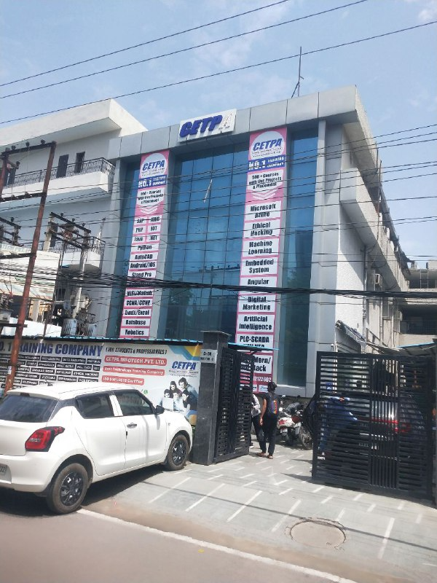


Slide 3




Slide 4
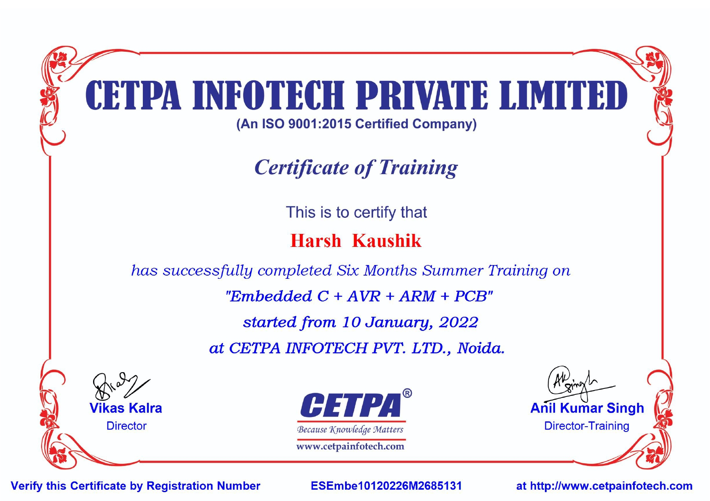

Slide 5
What is an Embedded System?
An Embedded System can be best described as a system which has both the hardware and software and is designed to do a specific task. A good example for an Embedded System, which many households have, is a Washing Machine. We use washing machines almost daily but wouldn’t get the idea that it is an embedded system consisting of a Processor (and other hardware as well) and software.
A modern day Car has several individual embedded systems that perform their specific tasks with the aim of making a smooth and safe journey.Some of the embedded systems in a Car are Anti-lock Braking System (ABS), Temperature Monitoring System, Automatic Climate Control, Tire Pressure Monitoring System, Engine Oil Level Monitor, etc.

Slide 6
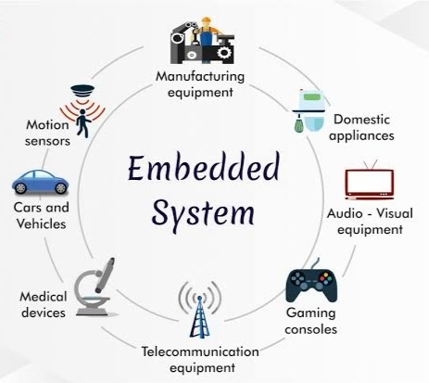
Programming Embedded Systems.
If we consider a simple Embedded System, the main Hardware Module is the Processor. The Processor is the heart of the Embedded System and it can be anything like a Microprocessor, Microcontroller, DSP, CPLD (Complex Programmable Logic Device) or an FPGA (Field Programmable Gated Array).
All these devices have one thing in common: they are programmable i.e., we can write a program (which is the software part of the Embedded System) to define how the device actually works.
There are many programming languages that are used for Embedded Systems like Assembly (low-level Programming Language), C, C++, JAVA (high-level programming languages), Visual Basic, JAVA Script (Application level Programming Languages), etc.

Slide 7
Factors for Selecting the Programming Language.
Size: The memory that the program occupies is very important as Embedded Processors like Microcontrollers have a very limited amount of ROM (Program Memory).Speed: The programs must be very fast i.e., they must run as fast as possible. The hardware should not be slowed down due to a slow running software.Portability: The same program can be compiled for different processors.Ease of ImplementationEase of MaintenanceReadability
Some of the benefits of using Embedded C as the main Programming Language:Significantly easy to write code in CConsumes less time when compared to AssemblyMaintenance of code (modifications and updates) is very simpleMake use of library functions to reduce the complexity of the main codeYou can easily port the code to other architecture with very little modifications

Slide 8

Introduction to Embedded C Programming Language
The C Programming Language, developed by Dennis Ritchie in the late 60’s and early 70’s, is the most popular and widely used programming language.
The C Programming Language provided low level memory access using an uncomplicated compiler (a software that converts programs to machine code) and achieved efficient mapping to machine instructions.
Embedded C Programming Language, which is widely used in the development of Embedded Systems, is an extension of C Program Language.
The Embedded C Programming Language uses the same syntax and semantics of the C Programming Language like main function, declaration of datatypes, defining variables, loops, functions, statements, etc.
The extension in Embedded C from standard C Programming Language include I/O Hardware Addressing, fixed point arithmetic operations, accessing address spaces, etc.

Slide 9
Difference between C and Embedded C
There is actually not much difference between C and Embedded C apart from few extensions and the operating environment. Both C and Embedded C are ISO Standards that have almost same syntax, datatypes, functions, etc.
Embedded C is basically an extension to the Standard C Programming Language with additional features like Addressing I/O, multiple memory addressing and fixed-point arithmetic, etc.C Programming Language is generally used for developing desktop applications, whereas Embedded C is used in the development of Microcontroller based applications.

Slide 10
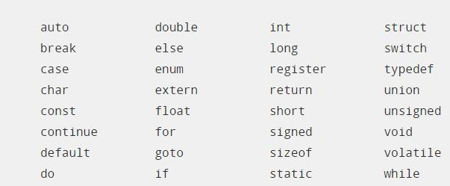
Keywords in Embedded C.
Keyword is a special word with a special meaning to the compiler (a C Compiler for example, is a software that is used to convert program written in C to Machine Code).
For example, if we take the Keil’s Cx51 Compiler (a popular C Compiler for 8051 based Microcontrollers) the following are some of the keywords:
The following table lists out all the keywords associated with the Cx51 C Compiler.

Slide 11
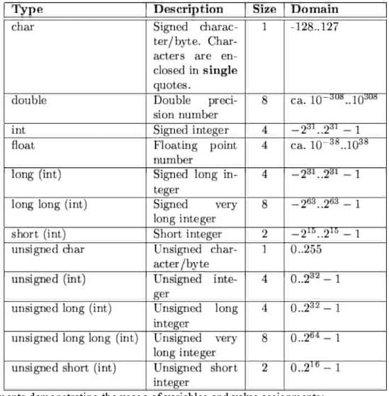
Data Types in Embedded C.
Data Types in C Programming Language (or any programming language for that matter) help us declaring variables in the program.
There are many data types in C Programming Language like signed int, unsigned int, signed char, unsigned char, float, double, etc.
In addition to these there few more data types in Embedded C.The following are the extra data types in Embedded C associated with the Keil’s Cx51 Compiler.Bitsbitsfrsfr16

Slide 12
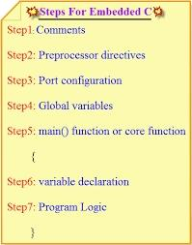
Basic Structure of an Embedded C Program.
The following part shows the basic structure of an Embedded C Program.Multiline Comments . . . . . Denoted using /*……*/Single Line Comments . . . . . Denoted using //Preprocessor Directives . . . . . #include<…> or #defineGlobal Variables . . . . . Accessible anywhere in the programFunction Declarations . . . . . Declaring FunctionMain Function . . . . . Main Function, execution begins here{Local Variables . . . . . Variables confined to main functionFunction Calls . . . . . Calling other FunctionsInfinite Loop . . . . . Like while(1) or for(;;)Statements . . . . .….….}Function Definitions . . . . . Defining the Functions{Local Variables . . . . . Local Variables confined to this FunctionStatements . . . . .….….}

Slide 13
Different Componentof an Embedded C Program , Comments :
Comments are readable text that are written to help us (the reader) understand the code easily.
They are ignored by the compiler and do not take up any memory in the final code (after compilation).
There are two ways you can write comments: one is the single line comments denoted by // and the other is multiline comments denoted by /*….*/.

Slide 14
Preprocessor Directive:
A Preprocessor Directive in Embedded C is an indication to the compiler that it must look in to this file for symbols that are not defined in the program.
In C Programming Language (also in Embedded C), Preprocessor Directives are usually represented using # symbol like #include… or #define…
In Embedded C Programming, we usually use the preprocessor directive to indicate a header file specific to the microcontroller, which contains all the SFRs and the bits in those SFRsIn case of 8051, Keil Compiler has the file “reg51.h”, which must be written at the beginning of every Embedded C Program.

Slide 15
Variables and Functions
Global Variables: Global Variables, as the name suggests, are Global to the program i.e., they can be accessed anywhere in the program.
Local Variables: Local Variables, in contrast to Global Variables, are confined to their respective function.
Main Function: Every C or Embedded C Program has one main function, from where the execution of the program begins.

Slide 16
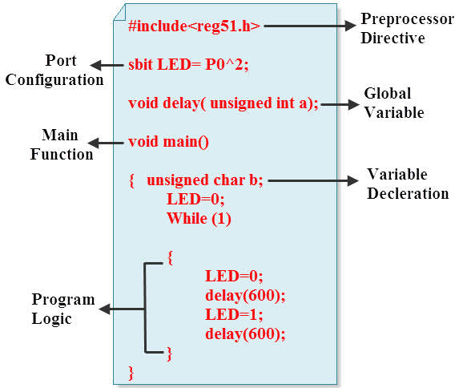
Basic Embedded C Program
#include<reg51.h> // Preprocessor Directivevoid delay (int); // Delay Function Declarationvoid main(void) // Main Function{P1 = 0x00;/* Making PORT1 pins LOW. All the LEDs are OFF. * (P1 is PORT1, as defined in reg51.h) */while(1) // infinite loop{P1 = 0xFF; // Making PORT1 Pins HIGH i.e. LEDs are ON.Delay(1000);/* Calling Delay function with Function parameter as 1000. * This will cause a delay of 1000mS i.e. 1 second */P1 = 0x00; // Making PORT1 Pins LOW i.e. LEDs are OFF.Delay(1000);}}void delay (int d) // Delay Function Definition{unsigned int i=0; // Local Variable. Accessible only in this function./* This following step is responsible for causing delay of 1000mS * (or as per the value entered while calling the delay function) */for(; d>0; d–){for(i=250; i>0; i – -);for(i=248; i>0; i – -);}}

Slide 17
Basics of PCB
PCB is a copper laminated and non-conductive Printed Circuit Board, in which all electrical and electronic components are connected together in one common board with physical support for all components with base of board.
There are several types of PCB available for the circuit. Out of these types of PCB, we have to choose the appropriate type of PCB according to our application.Single-layer PCBDouble-layer PCBMulti-layer PCBFlexible PCBAluminium backed PCBFlex-rigid PCB

Slide 18
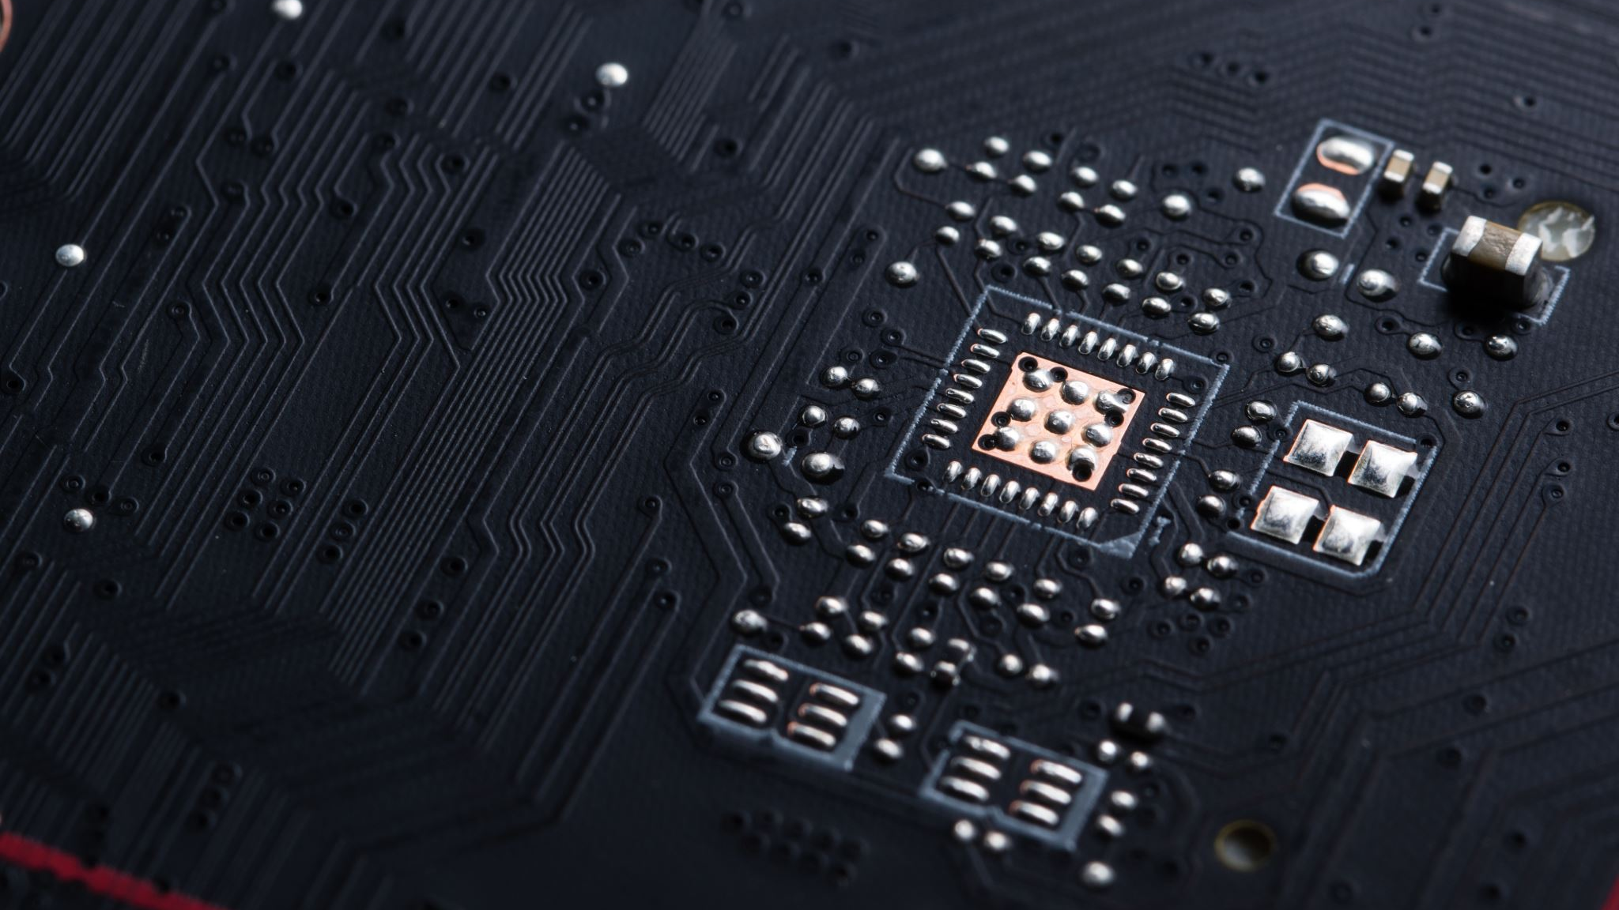
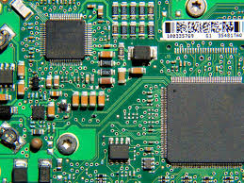
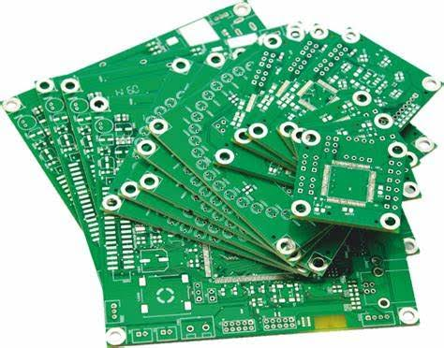
Types of PCBs According to Mounting System
Through-hole PCB Surface mounted PCB

Slide 19
Different Parts of PCB:
Pad: Pad is nothing but a piece of copper on which lead of components are mounted and on which soldering are done. Pad provides the mechanical support to the components.Trace: In PCB, components are not connected with the help of wires.
All components are connected with a conducting material like copper. This copper part of PCB which is used to connect all components that is known as trace.
Trace is looks like below figure.Layers: According to application, cost and available space of circuit, user can choose the layer of PCB.
Most simple in construction, easy to design and most useful in routine life is single layer PCB. But for very large and complex circuit, double layer PCB or Multi-layer PCB is most preferred compared to single layer PCB.
Now a day, in multi-layer PCB, 10-12 layers can be connected and most critical thing is to communicate between the components in different layer.Silk layer: Silk layer is used for printing line, text or any art on the surface of PCB.
Usually, for screen printing epoxy ink is used. Silk layer can be used in top and/or bottom layer of PCB according to user requirement which is known as silk screen TOP and silk screen BOTTOM.
Top and bottom layer: In Top layer of PCB, all components are mounted in this layer of PCB.
Generally, this layer is green coloured. In bottom layer of PCB, all components are soldered through the hole and lead of components is known as bottom layer of PCB.
Sometime, in top and/or bottom layer PCB is coated with green colour layer, which is known as solder mask.Solder Mask: There is one additional layer on the top of copper layer called as Solder Mask. This layer generally has green color but it can be of any color. This insulating layer is used for to prevent accidental contact of pads with other conductive material on PCB.

Slide 20
PCB Materials:
FR4:FR is stand for FIRE RETARDENT. For all type of PCB manufacturing, most common glass laminated material is FR4. Based on woven glass-epoxy compounds, FR4 is a composite material which is most useful because it provides very good mechanical strength.
FR-1 and FR-2:This material is made from paper and phenol compounds and this material is used for only single layer PCB. Both FR1 and FR2 has similar characteristic, the only difference is glass transition temperature. FR1 has higher glass transition temperature compared to FR2. These materials is also sub divided in standard, halogen free and non-hydrophobic.

Slide 21
CEM 1 , CEM 3 , POLYMIDE , PREPRAG
These material is made from paper and two layer of woven glass epoxy and phenol compounds and this material is used for Single sided PCB only. CEM-1 can used instead of FR4, but price of CEM1 is higher than FR4.
This material is white coloured, glass epoxy compound which is mostly used in double layer PCB. CEM-3 has lower mechanical strength compared to FR4, but it is cheaper than FR4. So, this is a good alternative of FR4.
This material is used in flexible PCB. This material is made from kepton, rogers, dupont. This material has good electrical properties, felicity, wide temperature range and high chemical resistance. Working temperature of this material is -200 ͦC to 300 ͦC.
Prepreg means pre-impregnated. It is a Fiberglass impregnated with resin. These resins are pre- dried, so that when it heated, it flows, sticks and completely immersed. Prepreg has adhesive layer which gives strength similar to FR4. There are many versions of this material according to resin content, SR- standard resin, MR- medium resin and HR- high resin. This is chosen according to required thickness, layer structure and impedance. This material also available in high glass transition temperature and halogen free.

Slide 22
PCB designing software:
EAGLE is a most popular and easiest way to design PCB.
EAGLE stands for Easily Applicable Graphical Layout Editor which is previously developed by CadSoft Computer and currently Autodesk is developer of this software.
For designing circuit diagram, EAGLE has a schematic editor. EAGLE file extension is .SCH and different parts and components are define in .LBR extension. Board file extension is .BRD
Multisim is also very powerful and easy learning software. Which is originally developed by Electronics Workbench and now it is a division of National Instruments (NI).
It includes microcontroller simulation (MultiMCU) and integrated import export features to the PCB layout software.
This software is widely used in academic and also in industry for circuit education.

Slide 23
EasyEDA , Altium , KiCad
EasyEDA is a software which is used to design and simulate circuits. This software is an integrated tool for schematic capture, SPICE circuit simulation, based on Ngspice and PCB layout. Most important advantage of this software is that, it is web based software and used in browser window. So, this software is independent from OS.
Altium Designer :This software is developed by Australian software company Altium Limited. The main feature of this software is schematic capture, 3D PCB design, FPGA development and release/data management. This is first software which offer 3D visualization and clearance checking of PCB directly from PCB editor.
KiCad: This software is developed by jean-pierre charras. This software has tools which can create BoM (Bill of Material), artwork and 3D view of PCB as well as all components used in circuit. Many components are available in the library of this software and there is feature that user can add their custom components. This software is support many human languages.CircuitMaker: This software is also developed by Altium. Schematic editor of this software includes basic component placement and this software is used to design advanced multichannel and hierarchical schematics. All schematic is uploaded to server and these files are available to view by anyone, provided that you need a CircuitMaker account.

Slide 24
ARM Processors
The ARM microcontroller stands for Advance RISC Machine; it is one of the extensive and most licensed processor cores in the world.
The first ARM processor was developed in the year 1978 by Cambridge University, and the first ARM RISC processor was produced by the Acorn Group of Computers in the year 1985.
These processors are specifically used in portable devices like digital cameras, mobile phones, home networking modules and wireless communication technologies and other embedded systems due to the benefits, such as low power consumption, reasonable performance, etc.
This article gives an overview of ARM architecture with each module’s principle of working.

Slide 25
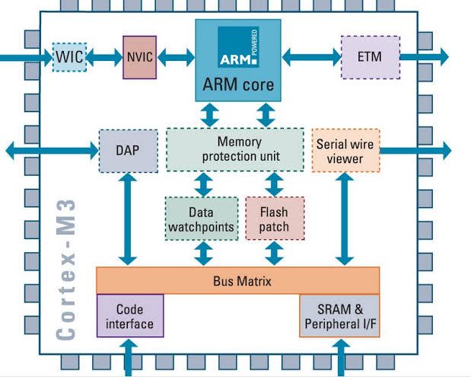
The ARM Architecture
Arithmetic Logic Unit
Booth multiplier
Barrel shifter
Control unit
Register file

Slide 26
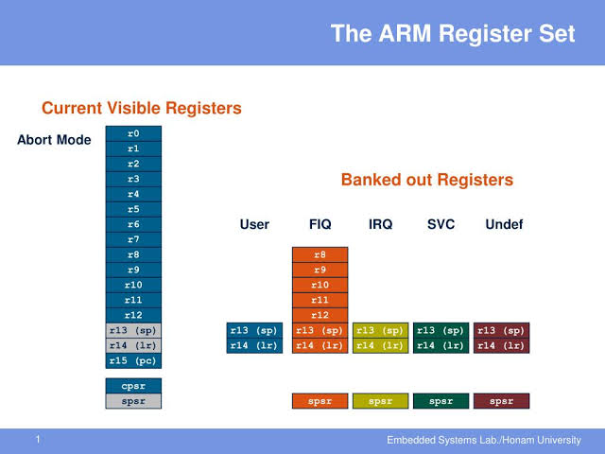
ARM Register Modes :
USER ModeFIQ ModeIRQ ModeSVC ModeUNDEFINED ModeABORT ModeMonitor Mode

Slide 27
Features of ARM
The main features of ARM Processor are mentioned below : Multiprocessing Systems – ARM processors are designed so that they can be used in cases of multiprocessing systems where more than one processors are used to process information.
First AMP processor introduced by name of ARMv6K had ability to support 4 CPUs along with its hardware. Tightly Coupled Memory – Memory of ARM processors is tightly coupled.
This has very fast response time. It has low latency (quick response) that can also be used in cases of cache memory being unpredictable. Memory Management – ARM processor has management section. This includes Memory Management Unit and Memory Protection Unit.
These management systems become very important in managing memory efficiently. Thumb-2 Technology – Thumb-2 Technology was introduced in 2003 and was used to create variable length instruction set.
It extends 16-bit instructions of initial Thumb technology to 32-bit instructions. It has better performance than previously used Thumb technology.
One cycle execution time – ARM processor is optimized for each instruction on CPU. Each instruction is of fixed length that allows time for fetching future instructions before executing present instruction. ARM has CPI (Clock Per Instruction) of one cycle.
Pipelining – Processing of instructions is done in parallel using pipelines. Instructions are broken down and decoded in one pipeline stage.
The pipeline advances one step at a time to increase throughput (rate of processing).Large number of registers – Large number of registers are used in ARM processor to prevent large amount of memory interactions.
Registers contain data and addresses. These act as local memory store for all operations.

Slide 28

Addressing Modes in ARM
Register indirect addressing mode In this addressing mode, a register is used to give the address of the memory location to be accessed.
E. G. LDR R0, [R1] This instruction will load the register R0 with the 32-bit word at the memory address held in the register R1Relative register indirect addressing mode In this addressing mode the memory address is generated by an immediate value added to a register.
Pre index and post index are supported in this addressing mode. E. G. (a) LDR R0, [R1, #4]This instruction will load the register R0 with the word at the memory areas calculated by adding the constant address contained in the R1 register value 4 to the memory address contained in R1 register e.g. (b) LDR R0, [R1, #4]!This is a pre-index addressing.
This instruction is same \as that in e. G. (a) this instruction also places the new address in R1 i.e R1 (R1 + 4. e.g. (c)‘LDR, [R1], #4This is post-index addressing. This instruction will load register R0 with the word at memory address given in register R1.
It will then calculate the new address by adding 4 to R1 and place this new address in R1Base indexed indirect addressing mode In this addressing mode the memory address is generated by adding the values of two registers. Pre-index and post-index are supported also in this addressing mode. E.g. (a) LDR R0, [R1, R2]This instruction will load the register R0 with the word at memory address calculated by adding register R1 to register R2. e.g. (b) LDR R0, [R1, R2]!This is pre-index addressing. This instruction is same as that in e.g. (a).
This instruction also places the new address in R1 i. E. R1 (-R1 + R2. e.g. (c) LDR R0, [R1], R2This is a post-index addressing. This instruction will load register R0 with the word at memory address given in register R1.
It will then calculate the new address by adding the value in register R2 to register R1 and Place this new address in R1.(iv) Base with scaled register addressing mode In this addressing mode the memory address is generated by a register value added to another register shifted left. Pre-index and post-index are supported in this addressing mode.
E.g. (a) LDR R0, [R1, R2, LSL #2]This instruction will load the register R0 with the word at the memory address calculated by adding register leith register R2 shifted left by 2 bits. E.g. (b) LDR RO,[R1, R2,_LSL #2]!This is a pre-indexed addressing. This instruction will load the register R0 with the word at the memory address calculated by adding register R1 with register R2 shifted left by 2 bits. The new address is placed in register R1.i.e.R1e-R1+R2 <<2.e.g. (c) LDR R0, [R1

Slide 29
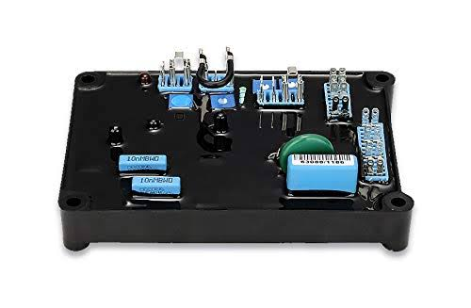
AVR
AVR is a family of microcontrollers developed since 1996 by Atmel, acquired by Microchip Technology in 2016.
These are modified Harvard architecture 8-bit RISC single-chip microcontrollers.
AVR was one of the first microcontroller families to use on-chip flash memory for program storage, as opposed to one-time programmable ROM, EPROM, or EEPROM used by other microcontrollers at the time.

Slide 30
Features :
Multifunction, bi-directional general-purpose I/O ports with configurable, built-in pull-up resistors.
Internal, self-programmable instruction flash memory up to 256 KB (384 KB on Xmega)
Internal data EEPROM up to 4 KBInternal SRAM up to 16 KB (32 KB on Xmega)External 64 KB little endian data space on certain models, including the Mega8515 and Mega162.
Analog comparator10 or 12-bit A/D converters, with multiplex of up to 16 channels12-bit D/A converters
Ethernet controller supportLCD controller support
CAN controller support

Slide 31
Difference between AVR and ARM :
S.No. AVR ARM01. AVR micro controller refers to Advanced Virtual RISC (AVR). ARM micro controller refers to Advanced RISC Micro-controller (ARM).02.
It has bus width of 8 bit or 32 bit. It has bus width of 32 bit and also available in 64 bit.03. It uses ART, USART, SPI, I2C communication protocol. It uses SPI, CAN, Ethernet, I2S, DSP, SAI, UART, USART communication protocol.04. Its speed is 1 clock per instruction cycle.
Its speed is also 1 clock per instruction cycle.05. Its manufacturer is Atmel company. Its manufacturer is Apple, Nvidia, Qualcomm, Samsung Electronics and TI etc.06. It uses Flash, SRAM, EEPROM memory.
It uses Flash, SDRAM, EEPROM memory.07. Its family includes Tiny, Atmega, Xmega, special purpose AVR. Its family includes ARMv4, 5, 6, 7 and series.08. It is cheap and effective.
It provides high speed operation.09. Popular micro-controllers include Atmega8, 16, 32, Arduino Community. Popular micro-controllers include LPC2148, ARM Cortex-M0 to ARM Cortex-M7, etc.

Slide 32

ARM Instruction Sets :
1. Arithmetic and logic instructions: These are used to perform various arithmetic and logic operations. Here two source operands are used and the output of the operation is stored within the destination register.
The results of arithmetic and logic instructions can be directly written into the Program Counter as it is a general-purpose register.2.
Comparison instructions: The comparison instructions have the same format as that of arithmetic and logic instructions. With this instruction, the operation takes place on two operands but rather than storing the results in registers, the contents of flag registers get updated.

Slide 33
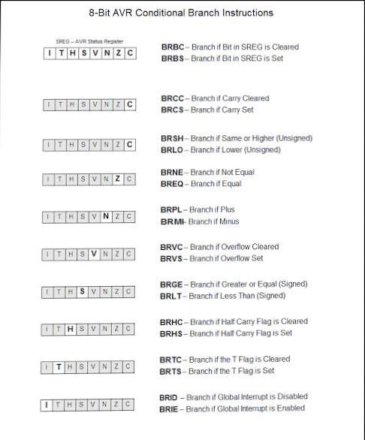
Instructions Set
3. Multiply instructions: According to the length of the bits after multiplication, this is divided into two classes, namely, 32-bit result: It is a normal result and all 32 bits of the result get stored within a register.
64-bit result: It is considered to be a long result and to store the 64 bit, two separate registers are required.4.Count leading zero instruction: Through this instruction, the device counts for the total number of zeros from MSB to LSB in the given sequence.
The count obtained gets stored in a register.

Slide 34
Instructions Set
5. Data processing instructions: This instruction is responsible for internal operations that are specifically registered for the co-processor.
6. Register transfer instructions: With this instruction, the data of the co-processor is transferred to or from the register. 7. Data transfer instructions: By using this instruction, the data of the co-processor is transferred to or from the memory, and the address of which is calculated by the processor.

Slide 35
Instructions Set
8. Software interrupts instruction: Through SWI instruction, software interrupts exception occurs. With this instruction, one demands OS-based service and by this the device switches to privileged processor mode. By doing so, an unfavorable operation accesses a favorable one in the manner which the operating system allows.
9. Software breakpoint instruction: Through BKPT instruction, an abort exception is generated. In the presence of debugger software, abort exception is treated as a breakpoint. While when there is debug hardware then abort exception does not occur and BKPT instruction is directly considered as a breakpoint.

Slide 36
Water Level Controller using Microcontroller:
This project monitors the water level of the tank and automatically switches on the pump motor when ever tank is empty. The motor is switched off automatically when container or overhead tank is full. The main principle used in this project is “water conducts electricity”. In this project water level of the overhead tank is indicated on a 16*2 LCD. In this system a set of 4 wires which are placed at different water levels can be used to sense the water levels. Based on the outputs of these wires controller displays the water level as well as controls the pump motor.
This system mainly works on a principle that “water conducts electricity”. The four wires which are dipped into the tank will indicate the different water levels. Based on the outputs of these wires, microcontroller displays water level on LCD as well as controls the motor Initially when the tank is empty, LCD will display the message LOW and motor runs automatically. When water level reaches to half level, now LCD displays HALF and still motor runs When the tank is full, LCD displays FULL and motor automatically stops. Again, the motor runs when water level in the tank becomes LOW..

Slide 37
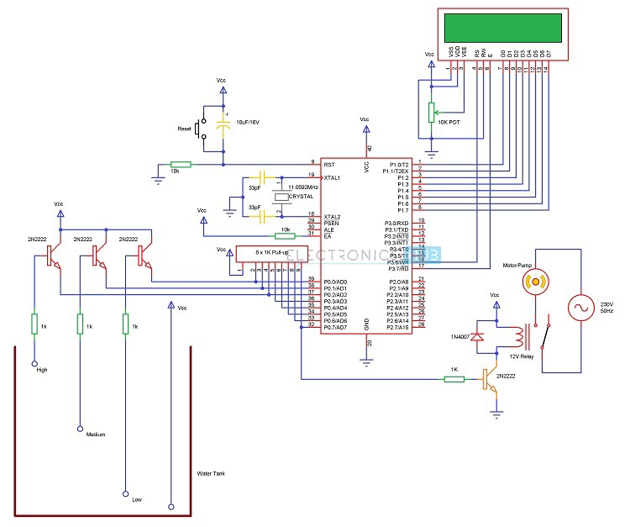
Circuit Diagram of the Water level Control

Slide 38
Algorithm for the Water level controller circuit
Algorithm for Water Level Controller Circuit First configure the controller pins P0.0, P0.1 and P0.2 as inputs and P0.7 as output. Now, initialize the LCD. Continuously check the water level input pins P0.0, P0.1 and P0.2. If all the pins are low, then display tank as “EMPTY” on the LCD and make P0.7 pin HIGH to run the motor automatically. If the level is low i.e. If P0.0 is HIGH, display the water level as “LOW” and continue to run the motor. A HIGH pulse on the pin P0.1 indicates that water has reached half level. So, display the same thing on LCD and run the motor normally. If P0.2 is HIGH, then the water level in the tank is FULL. Now, make the P0.7 pin as LOW to turn off the motor automatically.

Slide 39
Advantages :
Water Level Controller Circuit Advantages
Human effort is reduced as the system controls the motor automatically based on the water level.
This system consumes less power.
Simple and more reliable.
Applications of Water Level Controller Circuit using 8051 Used in big buildings where the manual monitoring is difficult. Used in industries to control the liquid level automatically.

Slide 40
Vehicle Tracking System Using GPS & GSM
Vehicle tracking system main aim is to give Security to all vehicles. Accident alert system main aim is to rescuing people in accidents.
This is improved security systems for vehicles. The latest like GPS are highly useful now a days, this system enables the owner to observe and track his vehicle and find out vehicle movement and its past activities of vehicle.
This new technology, popularly called vehicle Tracking Systems which created many wonders in the security of the vehicle. This hardware is fitted on to the vehicle in such a manner that it is not visible to anyone who is inside or outside of the vehicle.
Thus it is used as a covert unit which continuously or by any interrupt to the system, sends the location data to the monitoring unit. When the vehicle is stolen, the location data from tracking system can be used to find the location and can be informed to police for further action. Some Vehicle tracking System can even detect unauthorized movements of the vehicle and then alert the owner.
This gives an edge over other pieces of technology for the same purpose. This accident alert system in it detects the accident and the location of the accident occurred and sends GPS coordinates to the specified mobile, computer etc

Slide 41
WORKING
The project consists of GPS receiver and GSM modem with a micro controller. The whole system is attached to the vehicle. In the other end (main vehicle station) one GSM mobile phone is attached to the computer with VB application.
So the GPS system will send the longitudinal and altitude values corresponding to the position of vehicle to GSM Modem. Imagine the bus has left Bangalore at 6 o clock in the morning. If the officer in charge for that vehicle wants to know where the vehicle is, he will come to the computer and click on the vehicle number on the VB program .
The VB program will send an SMS to the vehicle number. The SMS sent would come through the GSM service provider and then reach the vehicle, which is traveling, because the vehicle has a GSM device with sim card.
This GSMmodem will receive the SMS and send to the microcontroller in the vehicle. The microcontroller will receive this SMS and compare the password and the command.
If every thing matches then it will perform the request required by the office. A place name is assigned for each longitude & latitude. The GSM receiver in the vehicle office receives these data & gives to the PC through serial port.
The VB program in the PC checks this data with its database & displays the details of the vehicle on the screen. The device is password controlled i.e. person who knows the device password only able to operate.
In case of any mishaps such as fire , theft or obstacle ,the device will automatically will send an alert to the registered number,i.e, the number that is feeded into the memory of microcontroller .

Slide 42
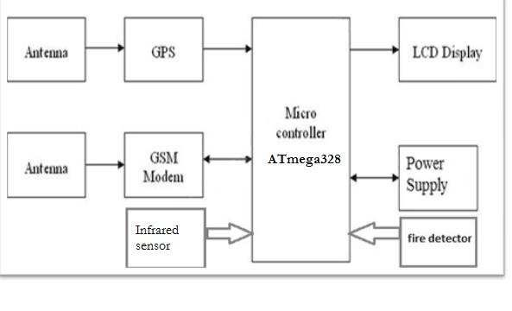
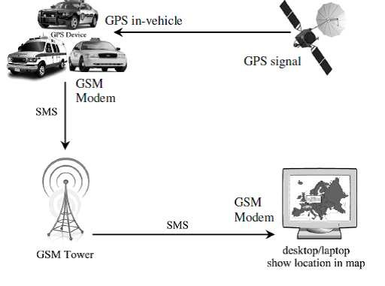
BLOCK-DIAGRAM

Slide 43
Global Positioning System
The Global Positioning System (GPS), originally Navstar GPS,[2] is a satellite-based radionavigation system owned by the United States government and operated by the United States Space Force.
It is one of the global navigation satellite systems (GNSS) that provides geolocation and time information to a GPS receiver anywhere on or near the Earth where there is an unobstructed line of sight to four or more GPS satellites. Obstacles such as mountains and buildings can block the relatively weak GPS signals.
21 GPS satellites and three spare satellites are in orbit at 10,600 miles above the Earth. The satellites are spaced so that four satellites will be above the horizon from any point on Earth. Each satellite contains a computer, an atomic clock and a radio. With an understanding of its orbit and the clock, it continually broadcasts its changing position and time. (Once a day, each satellite checks its sense of time and position with a ground station and makes any minor correction.) On the ground, any GPS receiver contains a computer that “triangulates” its position by getting bearings from three satellites. The result is a geographic position – longitude and latitude – to, for most receivers, within 100 meters. If the receiver is also equipped with a display screen and a map, the position can be shown as well. If a fourth satellite can be received, the receiver/computer can figure out the altitude as well as the geographic position. If you are moving, your receiver may also calculate your speed and direction of travel and give you estimated arrival times to specified destinations.

Slide 44
Global System For Mobile Communication
The Global System for Mobile Communications (GSM) is a standard developed by the European Telecommunications Standards Institute (ETSI) to describe the protocols for second-generation (2G) digital cellular networks used by mobile devices such as mobile phones and tablets. It was first deployed in Finland in December 1991. The network is structured into several discrete section - Base station subsystem – the base stations and their controllers Network and Switching Subsystem – the part of the network most similar to a fixed network, sometimes just called the “core network” GPRS Core Network – the optional part which allows packet-based Internet connections Operations support system (OSS) – network maintenance

Slide 45
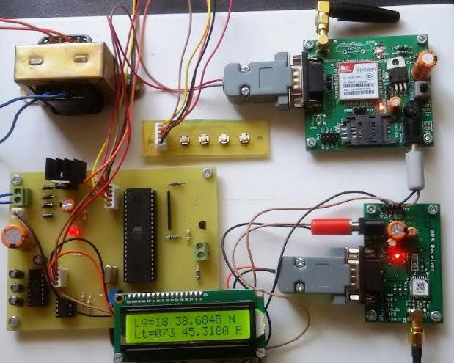
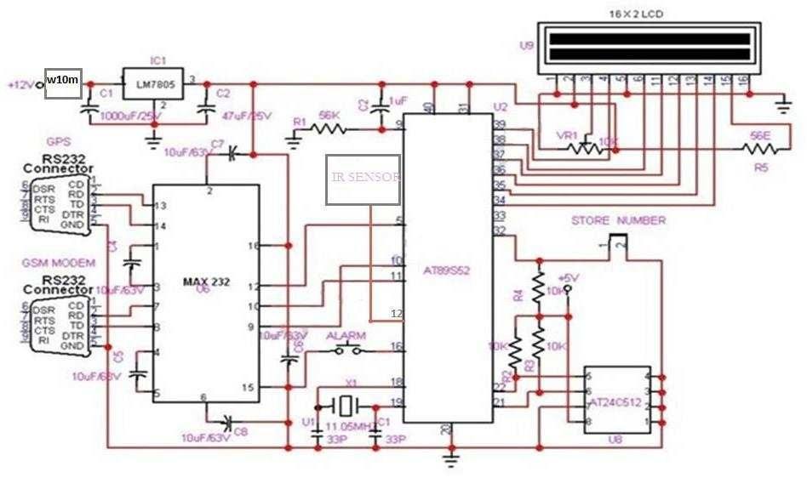
CIRCUIT DIAGRAM

Slide 46
APPLICATIONS :
The project that has been introduced here can be used for variety of applications –
1. Car navigation
2. Fleet management/tracking
3. Palmtop, Laptop, PDA, and Handheld
4. Location Based Services enabled devices

Slide 47
THANKING YOU
HARSH KAUSHIK

